Slide 1
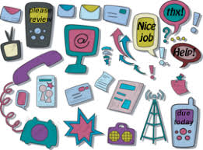
Technical Communication Style
Part III

Slide 2
Globalization and Style
Put only one idea in each sentence.
Stay away from examples that require readers to understand metaphors outside of their experience.
Consider your word choice.
Use consistent vocabulary.
Don’t switch to synonyms
Outlet: America
Socket: UK
Use an adequate mix between the active voice and the passive voice.
Write words in full instead of using contractions, especially in negative statements.
Use –ing and –ed forms carefully.

Slide 3
Choose a Tone for the Reader
Four Possible Tones
Forceful
Passive
Personal
Impersonal

Slide 4
Forceful Tone
I have decided to implement your suggestion that we supply all office workers with laptops and eliminate their towers. This suggestion is excellent. You have clearly made the case that this change will reduce eyestrain issues and will greatly enhance the flow of information in the department. Make an appointment with me so we can start to implement this fine idea.

Slide 5
Forceful Tone
It implies that the writer is in control of the situation or that the situation is positive
To write forcefully,
Use the active voice.
Use the subject–verb–object structure.
Do not use “weasel words” (possibly, maybe, perhaps).

Slide 6
Passive Tone
The proposal to implement laptops in our department has not been accepted because of a number of very difficult issues. To our surprise several people have indicated that the ergonomic benefits of the screens are not seen as not quite offsetting the potential disruption that will be caused by the migration of files to the new machines. The large footprint of the docking station has also been suggested as a possible problem for our employees due to their fairly restricted desk space. Because the need for action on computer replacement is necessary, a meeting will be scheduled next week to discuss this.

Slide 7
Passive Tone
It implies that the reader has more power than the writer or that the situation is negative.
To make the tone passive
Avoid imperatives
Use the passive voice
Use “weasel words” (very, several people, quite, fairly)
Use longer sentences
Do not explicitly take responsibility

Slide 8
Passive Tone
The proposal to implement laptops in our department has not been accepted because of a number of very difficult issues. To our surprise several people have indicated that the ergonomic benefits of the screens are not seen as not quite offsetting the potential disruption that will be caused by the migration of files to the new machines. The large footprint of the docking station has also been suggested as a possible problem for our employees due to their fairly restricted desk space. Because the need for action on computer replacement is necessary, a meeting will be scheduled next week to discuss this.

Slide 9
Compare this to a forceful presentation:
The steering committee and I reject the laptop proposal. You have not included enough convincing data on morale or work flow, and you have not dealt with work flow disruption and the large size of the docking station. Make an appointment to see me if necessary.

Slide 10
Personal Tone
Ted, thanks for that laptop suggestion. The steering committee loved it. Like you, we feel it will solve the eyestrain issue and will facilitate data flow. And we think it will also raise morale. I’d like you to begin work on this soon. Can you make an appointment to see me this week?
This tone is also appropriate for delivering a negative message when both parties are equal.
Ted, thanks for the laptop suggestion, but we can’t do it this cycle. The steering committee understands the ergonomic issue you raise, but they are very concerned about the disruption that migrating all those files will cause. In addition, they feel that we need to work out the entire issue of footprint—the model you suggested would cause a number of problems with current desk configurations. I know that this is a disappointment. Could we get together soon to discuss this?

Slide 11
Personal Tone
implies that reader and writer are equal.
Use the active voice.
Use first names.
Use personal pronouns.
Use short sentences.
Use contractions.
Direct questions at the reader.

Slide 12
Impersonal Tone
A decision to provide each employee with a laptop has been made. Laptops will reduce the eye fatigue that some employees have experienced, and the laptops will increase data flow. Ted Baxter will chair the implementation committee. Donna Silver and Robert will assist. The committee will hold its initial meeting on Monday, October 10, at 3:00 p.m. in Room 111.

Slide 13
Impersonal Tone
It implies that the writer is not important or that the situation is neutral.
To make the tone impersonal,
Do not use names, especially first names.
Do not use personal pronouns.
Use the passive voice.
Use longer sentences.

Slide 14
Objectives in Technical Communication
Understand
Understand that if your technical communication is unclear, your reader may do a job wrong, damage equipment, injure themselves, or contact you for further explanations
Use
Use details, specify, and quantify to ensure reader’s understanding
Answer
Answer who, what, when, where, why, and how (the reporter’s questions) to help determine which details to include
Avoid
Avoid words that are not commonly used including legalese and outdated terms
Avoid
Avoid passive voice constructions, which tend to lengthen sentences and confuse readers

Slide 15
Objectives in Technical Communication
Use
Use short, simple words (always considering your reader’s level of technical knowledge)
Limit
Limit the length of sentences by deleting expletives, “be” verbs, “shun” words, camouflaged words, and more
Use
Use Microsoft Word to determine your text’s readability
Use
Use different organizational patterns—spatial, chronological, importance, comparison/contrast, and problem/solution—to help you explain material
Evaluate
Evaluate your technical communication for clarity, conciseness, accuracy, and organization using a checklist

Slide 16
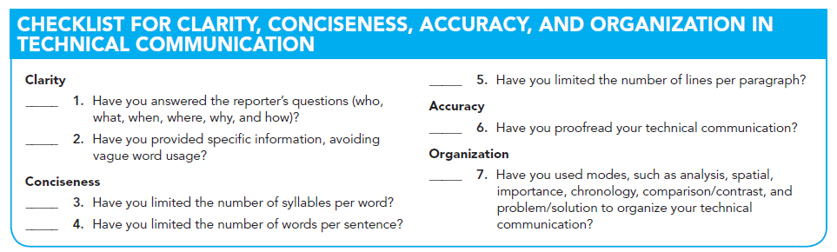

Slide 17

Any Questions?

